Slide 1
Field of study Laboratory of research PhD student Name Surname Supervisor – Dr Name Surname Consultant – Dr Name Surname
PhD thesis title
First/Second/Third year of PhD studies

Slide 2
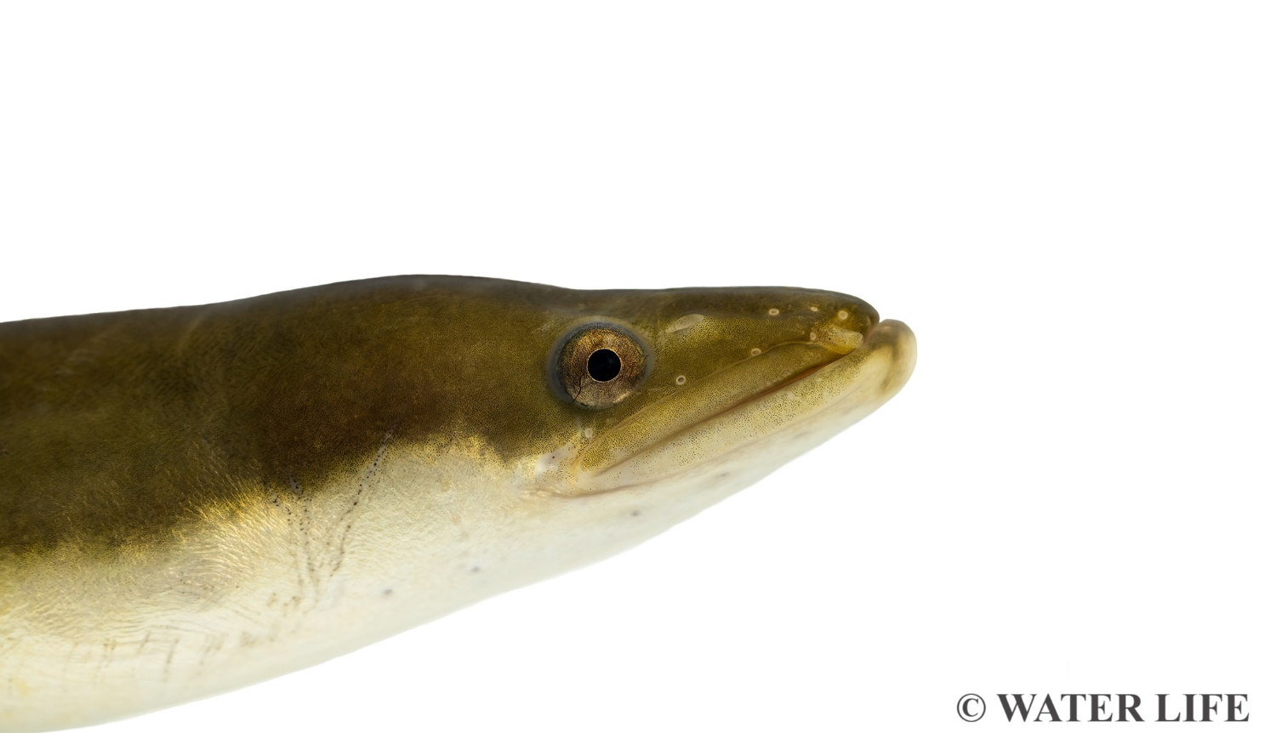
Introduction
Main object of the study, relevance, issues, significance.
BRIEF (The essence)
SIMPLE
UNDERSTANDABLE
Presentation is for the current year only

Slide 3
Aims and objectives
Main aim: the aim of your thesis
Objectives:
First objective
Second objective
...
You don't have to read the text on the slides – the slides should just contain the essence and are usually used as a guide, rather than read. You should guide the audience with the slides but also provide a captivating talk.

Slide 4
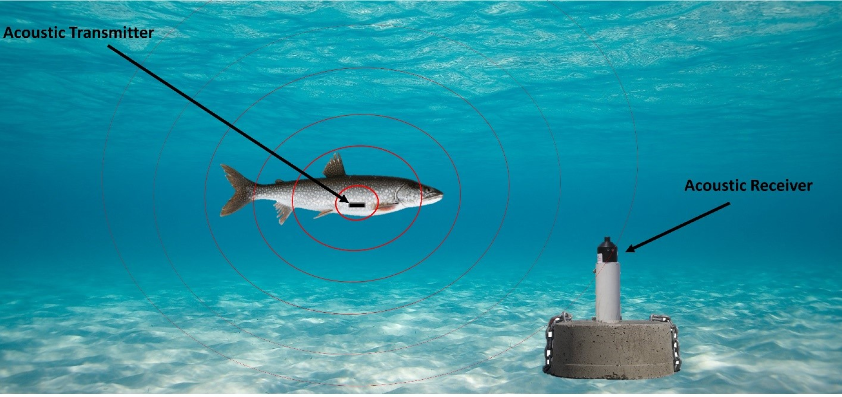
Materials and methods (1)
How much and what kind of material has been collected and what methods were used during the present year. Name and essence of the method.
No small details needed!
Illustrations are always better than text
Fig. 1. Telemetric fish monitoring system (www.ijc.org)

Slide 5
Materials and methods (2)

Slide 6
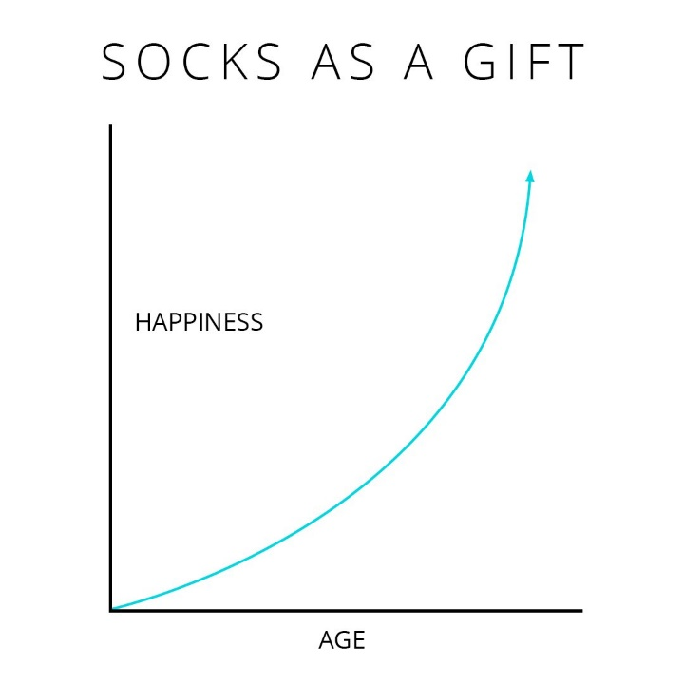
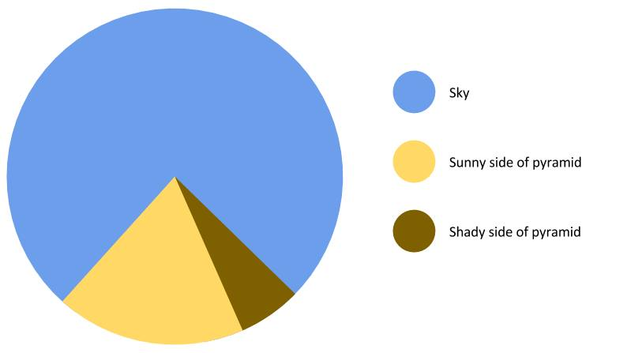
Results (1)
Key results for the current year. Indicate which of the results presented were not obtained by the PhD student.
The essence of the main results, without details.
As little text as possible.
Fig. 2 Sun effect on the colour of the pyramid
Fig. 3 What to buy for Christmas?

Slide 7
Results (2)
Presenting "naked numbers" is not enough. Briefly discuss their essence, in a regional/ thematic context.

Slide 8
Results (3)

Slide 9
Study plan, exams, internships
Table 1. Study progress according to the study plan
Work activity | Deadline | Status
Collecting samples in the field | 2023.01 – 2023.06 | Done
Laboratory analysis of collected samples | 2023.06 – 2023.09 | In progress
Drafting an article based on the material collected | Until 2023.10 | Delayed until 2023.11
Internship in Sweden | 2023.09 – 2023.10 | Will not be implemented
Exams:
Ecology, X credits, 10 points
Biology, X credits, 10 points

Slide 10
Scientific production
WOS Articles:
Surname N., Other Authors. Title. Journal, DOI (Submitted, Accepted) (Q1-Q4) (Orally present your input)
Non-WOS Articles:
International conferences:
Surname N., Other Authors. Title. Conference title. City, Country.(Oral presentation; Poster)
National conferences:
Directly related to your studies only!

Slide 11
Other
Other important information. If relevant, achievements, funding received, popular science dissemination, training, important changes to be mentioned, etc.

Slide 12
Thank you for your attention
Dr Justas Dainys, Dr Petras Prakas
Nature Research Centre
Early Career Researcher Committee
justas.dainys@gamtc.lt
Institutional e-mail address is recommended
www.gamtostyrimai.lt

