Slide 1
Field of study Laboratory of research PhD student Name Surname Supervisor – Dr Name Surname Consultant – Dr Name Surname
PhD thesis title
Fourth year of PhD studies

Slide 2
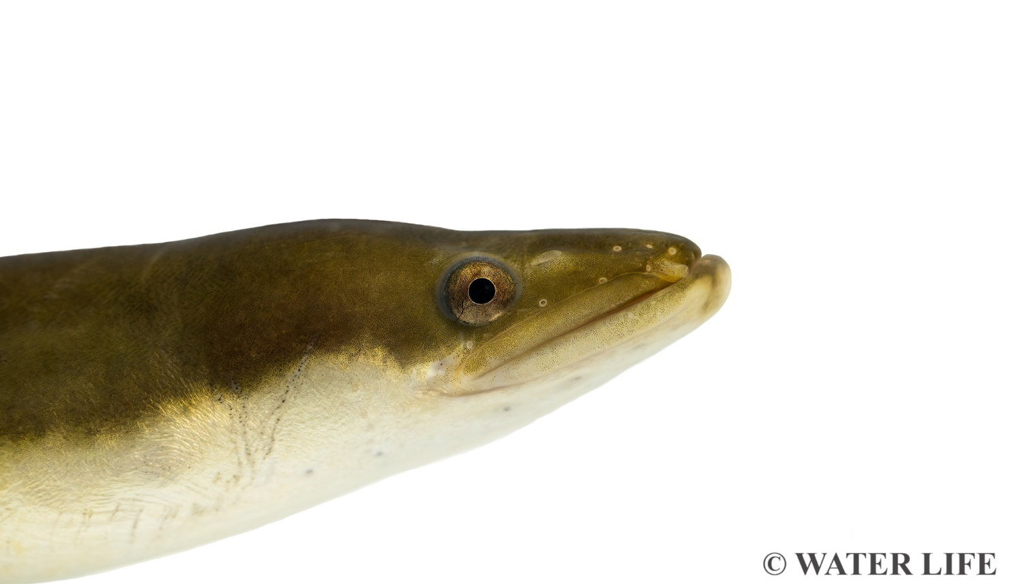
Introduction (1)
Main object of the study, relevance, issues, significance.
BRIEF (The essence)
SIMPLE
UNDERSTANDABLE
Presentation is for the whole study time

Slide 3
Introduction (2)

Slide 4
Aims and objectives
Main aim: the aim of your thesis
Objectives:
First objective
Second objective
...
You don't have to read the text on the slides – the slides should just contain the essence and are usually used as a guide, rather than read. You should guide the audience with the slides but also provide a captivating talk.

Slide 5
Statements to be defended
First statement
Second statement
...
„Statements to be defended“ are answers to the problematic questions raised during your PhD studies. They differ from hypotheses in that they are formulated after the research has been carried out and after the data have been summarised and interpreted.
They are generally specific, describing what the research has confirmed or revealed.
They should be reflected in the conclusions

Slide 6
Novelty
For the first time....
Present the novelty of the work in your own words, don't read word by word what is written in the slides. Emphasise and contextualise it in terms of international relevance.

Slide 7
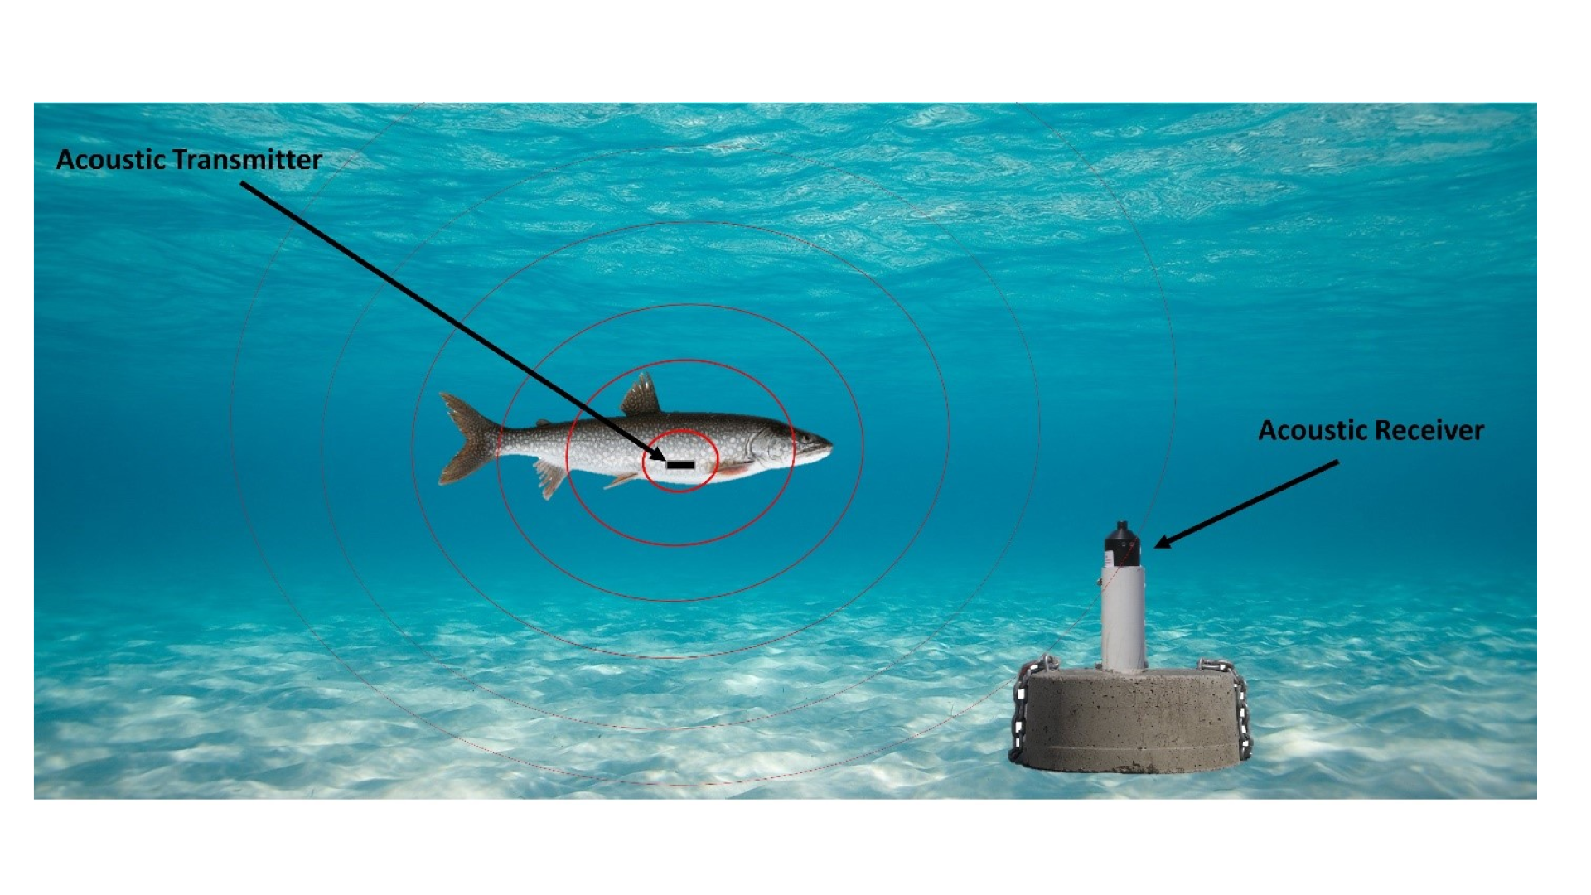
Materials and methods (1)
How much and what kind of material has been collected and what methods were used during the whole study time. Name and essence of the method.
No small details needed!
Illustrations are always better than text
Fig. 1. Telemetric fish monitoring system (www.ijc.org)

Slide 8
Materials and methods (2)

Slide 9
Materials and methods (3)

Slide 10
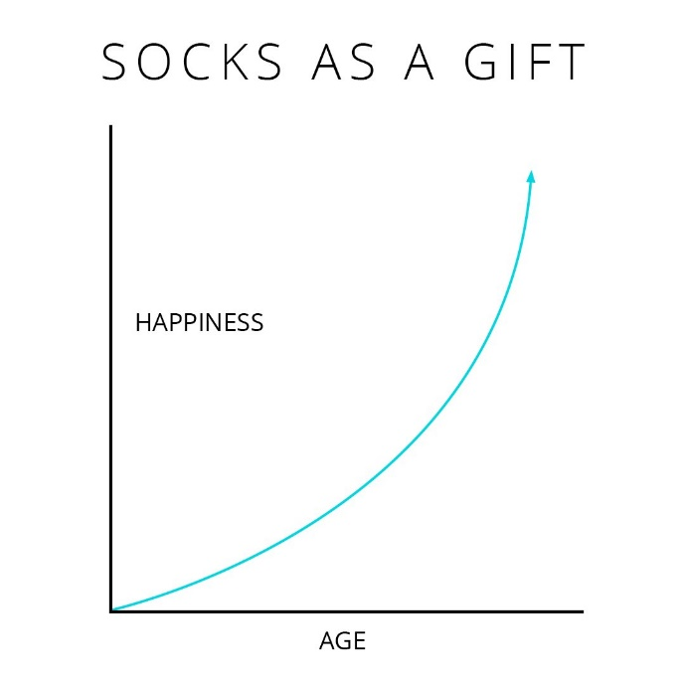
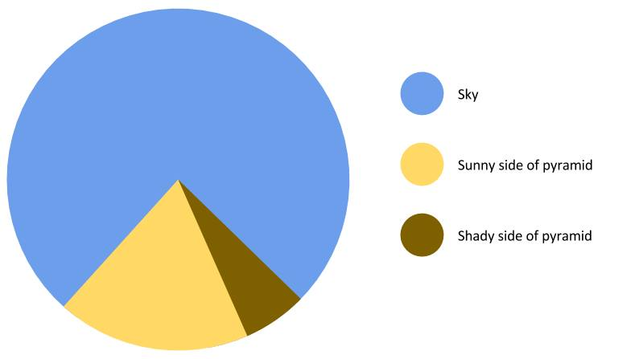
Results (1)
Key results for all study years. Indicate which of the results presented were not obtained by the PhD student.
The essence of the main results, without details.
As little text as possible.
Fig. 3 What to buy for Christmas?
Fig. 2 Sun effect on the colour of the pyramid

Slide 11
Results (2)
Presenting "naked numbers" is not enough. Briefly discuss their essence, in a regional/ thematic context.

Slide 12
Results (3)

Slide 13
Results (4)

Slide 14
Results (5)

Slide 15
Conclusions
First..
Second..
...
Concise, concrete conclusions meeting the objectives of the studies and reflecting the statements to be defended!

Slide 16
Scientific and practical significance
The results of the research will allow....
The essence and significance of your work in the context of previous research, and its implications for future work. The need and prospects for continuing research in this field. The applied value of your research - applicability to agriculture/business/nature conservation etc.

Slide 17
Exams, internships
Exams:
Ecology, X credits, 10 points
Biology, X credits, 10 points
...
Internships:
2022.04-2022.06 internship at the Swedish Agricultural University (SLU), Sweden
Other relevant information related to the preparation of the dissertation and eligibility
Do not spend a lot of time on this slide during the presentation. Exams should have been passed and internships completed.

Slide 18
Scientific production (1)
WOS Articles:
Surname N., Other Authors. Title. Journal, DOI (Submitted, Accepted) (Q1-Q4) (Orally present your input)
Non-WOS Articles:
International conferences:
Surname N., Other Authors. Title. Conference title. City, Country.(Oral presentation; Poster)
National conferences:
Directly related to your studies only!

Slide 19
Scientific production (2)

Slide 20
Final steps
Information on when the pre-defence/dissertation defence is planned and what is still missing for the dissertation to be fully prepared.
Other important information, if relevant, including achievements, funding received, science promotion, training, important changes to mention, etc.

Slide 21
Thank you for your attention
Dr Justas Dainys, Dr Petras Prakas
Nature Research Centre
Early Career Researcher Committee
justas.dainys@gamtc.lt
Institutional e-mail address is recommended
www.gamtostyrimai.lt

